Slide 1
ERLANG
rıdvan nuri göçmen
Erlang and Distributed Programming

Slide 2
Episode 1
Erlang
Distributed Programming
Erlang/OTP
Erlang Philosophy
Who is using Erlang?

Slide 3
Erlang
If Java is 'write once, run anywhere', then Erlang is 'write once, run forever’.
Joe Armstrong

Slide 4

> what is Erlang?
is a programming language used to build massively scalable soft real-time systems with requirements on high availability.
concurrency-oriented

Slide 5
> what is Erlang?
is a programming language specifically designed to build fault-tolerant, distributed systems which can contain a large number of concurrent processes.
high-level functional

Slide 6
> what is Erlang?
Erlang is a high-level functional and pattern matching language.
Erlang specifically designed to build fault-tolerant, distributed systems which can contain a large number of concurrent processes.
Erlang programs are made up of functions which are grouped into modules.
Functions spawn processes which are the executing elements of an Erlang system.

Slide 7
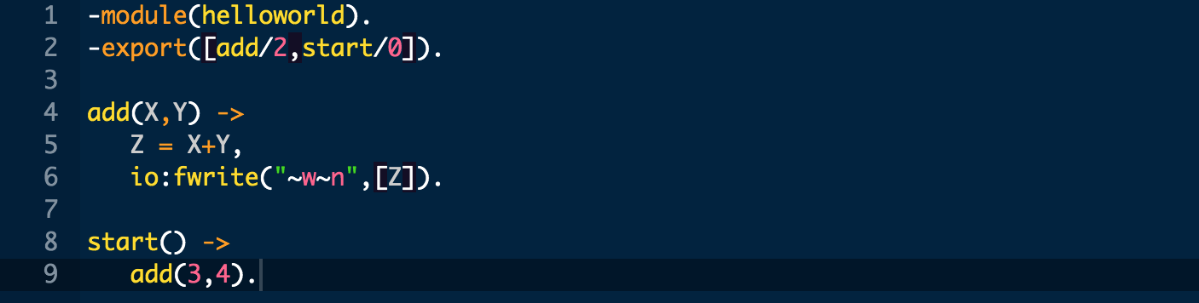
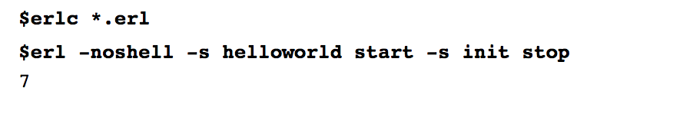
> basic syntax

Slide 8
> Erlang name
The name "Erlang", attributes to Bjarne Däcker.
The name "Erlang " is a syllabic abbreviation of "Ericsson Language".
The name "Erlang" has been presumed by those working on the telephony switches to be a reference to Danish mathematician and engineer Agner Krarup Erlang.

Slide 9
> Erlang history
Bjarne Däcker set up the Computer Science Lab together with Mike Williams.
Erlang was created at the CSLab by an initial team of Joe Armstrong, Mike Williams and Robert Virding.
Erlang was originally designed at Ericsson for programming embedded telephony systems.

Slide 10
> Erlang history
Who did what in Erlang Team? – Mike Williams
Joe: Invented the language, wrote the first compiler
Robert: Made the libraries and I/O system
Mike: Wrote the first virtual (JAM) machine, stuff for error handling and code replacement
Klacke: Added distribution and invented ETS, binaries & Mnesia
Bogdan: Made the first Beam machine
Per: Provided computer environment and kept the IS/IT people away
Kostis & Co: Made Beam really fast
Björn & Patrik: Made Beam even faster
Kenneth: Keeps the Erlang team together

Slide 11
> Erlang history
Erlang banned And has been released as open source
Ericsson Radio banned the use of Erlang (1998)
Decided to focus on C++, CPP (OSE) and modeling with UML
Erlang/OTP released as Open Source (1998)

Slide 12
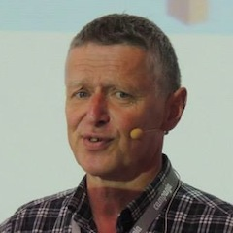
> Erlang history
Mike Williams
Software development is an art, not a science.
Wrote the first virtual (JAM) machine

Slide 13
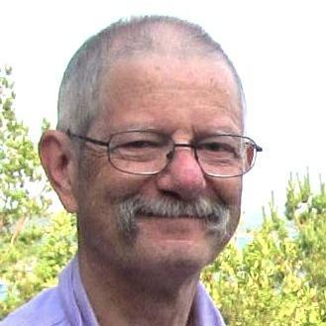
> Erlang history
Joe Armstrong
If Java is 'write once, run anywhere', then Erlang is 'write once, run forever’.
Author of the Erlang.
https://twitter.com/joeerl
https://joearms.github.io/

Slide 14
> key points
Erlang run its program in its own virtual machine.
Erlang processes do not create an OS thread for every created process. ( jvm creates a thread in os level for each jvm thread )
Usually the memory requirements for a thread is very low in Erlang, just about 512 bytes. So Erlang processes are lightweight.

Slide 15
> key points
Process creation time is of the order of microseconds and independent of the number of concurrently existing processes.
Erlang can create processes in 1 millisecond up to 2500 processes.
(create processes in java with small numbers it will usually take 300 milliseconds. )
Erlang was reported to have been used in production systems for over 20 years with an uptime percentage of 99.9999999%. These metrics are not absolute and depends on the environment.

Slide 16
Distributed Programming

Slide 17
> what is ds?
A distributed system is a system whose components are located on different networked computers.
System communicate and coordinate their actions by passing messages to one another.
There are many different types of implementations for the message passing mechanism, including pure HTTP, RPC-like connectors and message queues.

Slide 18
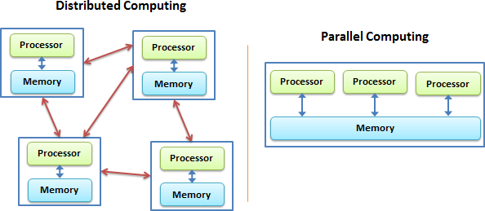
> what is ds?

Slide 19
> distributed erlang
A distributed Erlang system consists of a number of Erlang runtime systems communicating with each other.
Each such runtime system is called a node.
Message passing between processes at different nodes, as well as links and monitors, are transparent when pids are used.
The distribution mechanism is implemented using TCP/IP sockets.

Slide 20
> distributed erlang
Erlang Processes communicate by sending and receiving message via ports, which themselves behave like processes.
A built-in distribution mechanism enables designers to create a system whose processes may run on different computers.
Erlang handles fault detection and recovery in distributed systems.

Slide 21
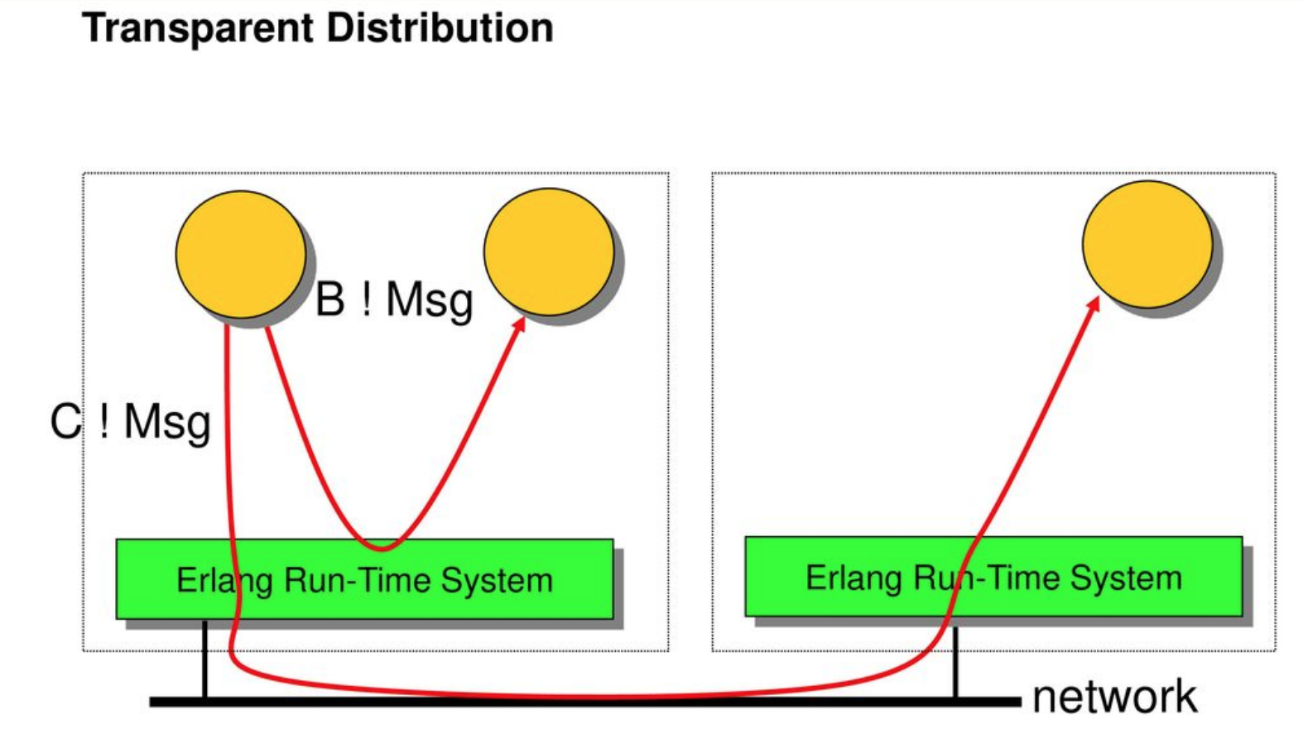
> distributed erlang

Slide 22
Erlang/OTP

Slide 23
> what is OTP?
's runtime system has built-in support for concurrency, distribution and fault tolerance.

Slide 24
> what is OTP?
OTP (Open Telecom Platform) is aimed at providing time-saving and flexible development for robust, adaptable telecom systems.
It consists of an Erlang runtime system, a number of ready-to-use components mainly written in Erlang, and a set of design principles for Erlang programs.
The Erlang runtime system (ERTS) is made up of an emulator running on top of the host operating system.

Slide 25
> what is OTP?
The Erlang runtime system is a kernel providing low-level services such as distribution and I/O handling, and a standard library containing a large number of re-usable modules.
The standard library includes behavior modules for supervisors, servers, state machines and generic event handlers.
ERS supervision tree is a hierarchical tree of processes used to program fault-tolerant systems.

Slide 26
> erlang VM
Erlang run its program in its own VM, just like Java, which is independent of platform.
The Erlang VM runs as one OS process.
If you are running an Erlang system of over one million processes it is still only one OS process and one thread per core.

Slide 27
> erlang VM
The BEAM emulator does the swap automatically without apparently stopping anything. This makes it possible to do upgrades with essentially zero downtime.
Erlang uses a private heap topology. Each thread has its own tiny heap . When the thread dies, the entire heap is simply returned to the pool of free memory.
For example JVM uses shared heap topology, there is one big heap that is used by all threads. Most memory is allocated by other threads.

Slide 28
> Erlang VM History
- the new BEAM - ( Bogdan/Björn's Erlang Abstract Machine ) | This is the virtual machine supported in the commercial release.
JAM - ( Joe's Abstract Machine ) | the original Erlang virtual machine.
old BEAM - this was an attempt to compile Erlang to C, and then compile the C to native code. It was abandoned after benchmarking showed that the resulting code was only faster than VM-based Erlang for small programs.

Slide 29
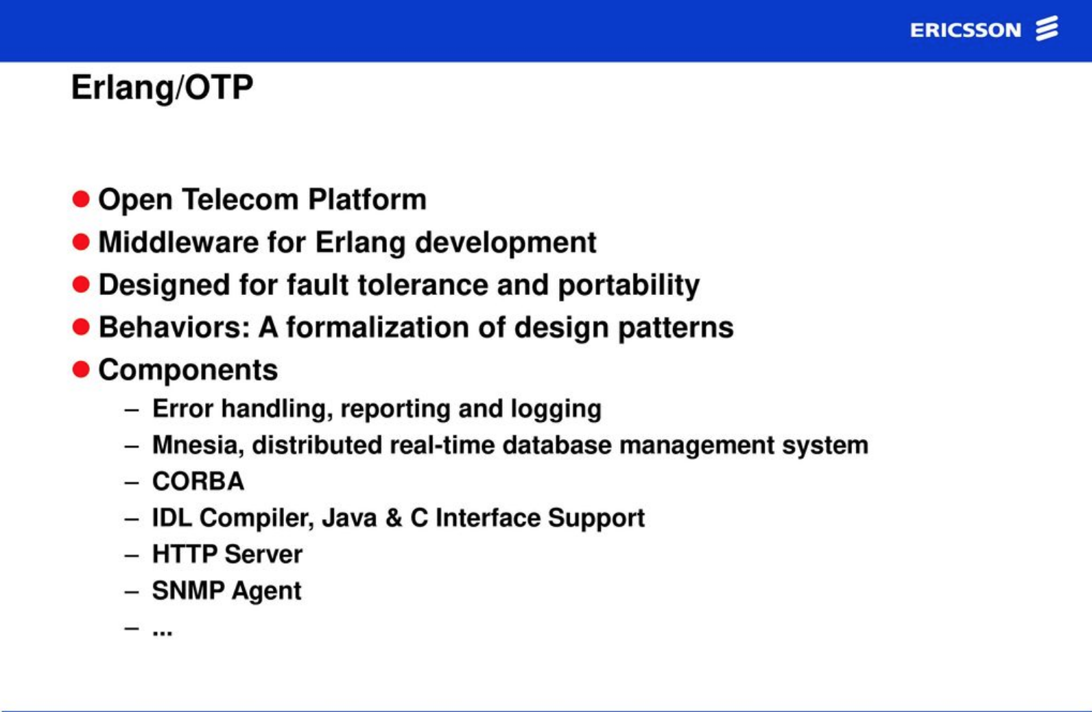
> OTP details

Slide 30
> components
Basic Applications - Basic Erlang/OTP functionality.
Compiler A compiler for Erlang modules.
Kernel Functionality necessary to run Erlang/OTP itself.
SASL (System Architecture Support Libraries) A set of tools for code replacement and alarm handling etc.
Stdlib The standard library.

Slide 31
> components
Operations and Maintenance
EVA A multi-featured event and alarm handler.
OS_Mon A monitor which allows inspection of the underlying operating system.
SNMP SNMP support including a MIB compiler and tools for creating SNMP agents.

Slide 32
> components
Interface and Communication
Asn1 Support for ASN.1.
Comet A library that enables Erlang/OTP to call COM objects on windows
Crypto Cryptographical support
Erl_Interface Low level interface to C.
GS A graphics system used to write platform independent user interfaces.
Inets A set of services such as a web server and a FTP client.
Jinterface Low level interface to Java.
SSL Secure Socket Layer (SSL),interface to UNIX BSD sockets

Slide 33
> components
Database Management
QLC Query language support for Mnesia DBMS.
Mnesia A heavy duty real-time distributed database.
ODBC ODBC database interface

Slide 34
> components
Tools
Appmon A utility used to view OTP applications.
Debugger For debugging and testing of Erlang programs.
Parsetools A set of parsing and lexical analysis tools.
Pman A process manager used to inspect the state of an Erlang/OTP system.
Runtime_Tools Tools to include in a production system.
Toolbar A tool bar simplifying access to the Erlang/OTP tools.
Tools A set of programming tools including a coverage analyzer etc.
TV An ETS and Mnesia graphical table visualizer.
Feel free for contribute => https://github.com/erlang/otp

Slide 35
Erlang Philosophy

Slide 36
> problem?
Building massively scalable software
Building reliable software
Building software with fault tolerance

Slide 37
> solution?
Erlang’s concurrency design for scale
Erlang’s failure handlers
Erlang’s built in fault tolerance

Slide 38
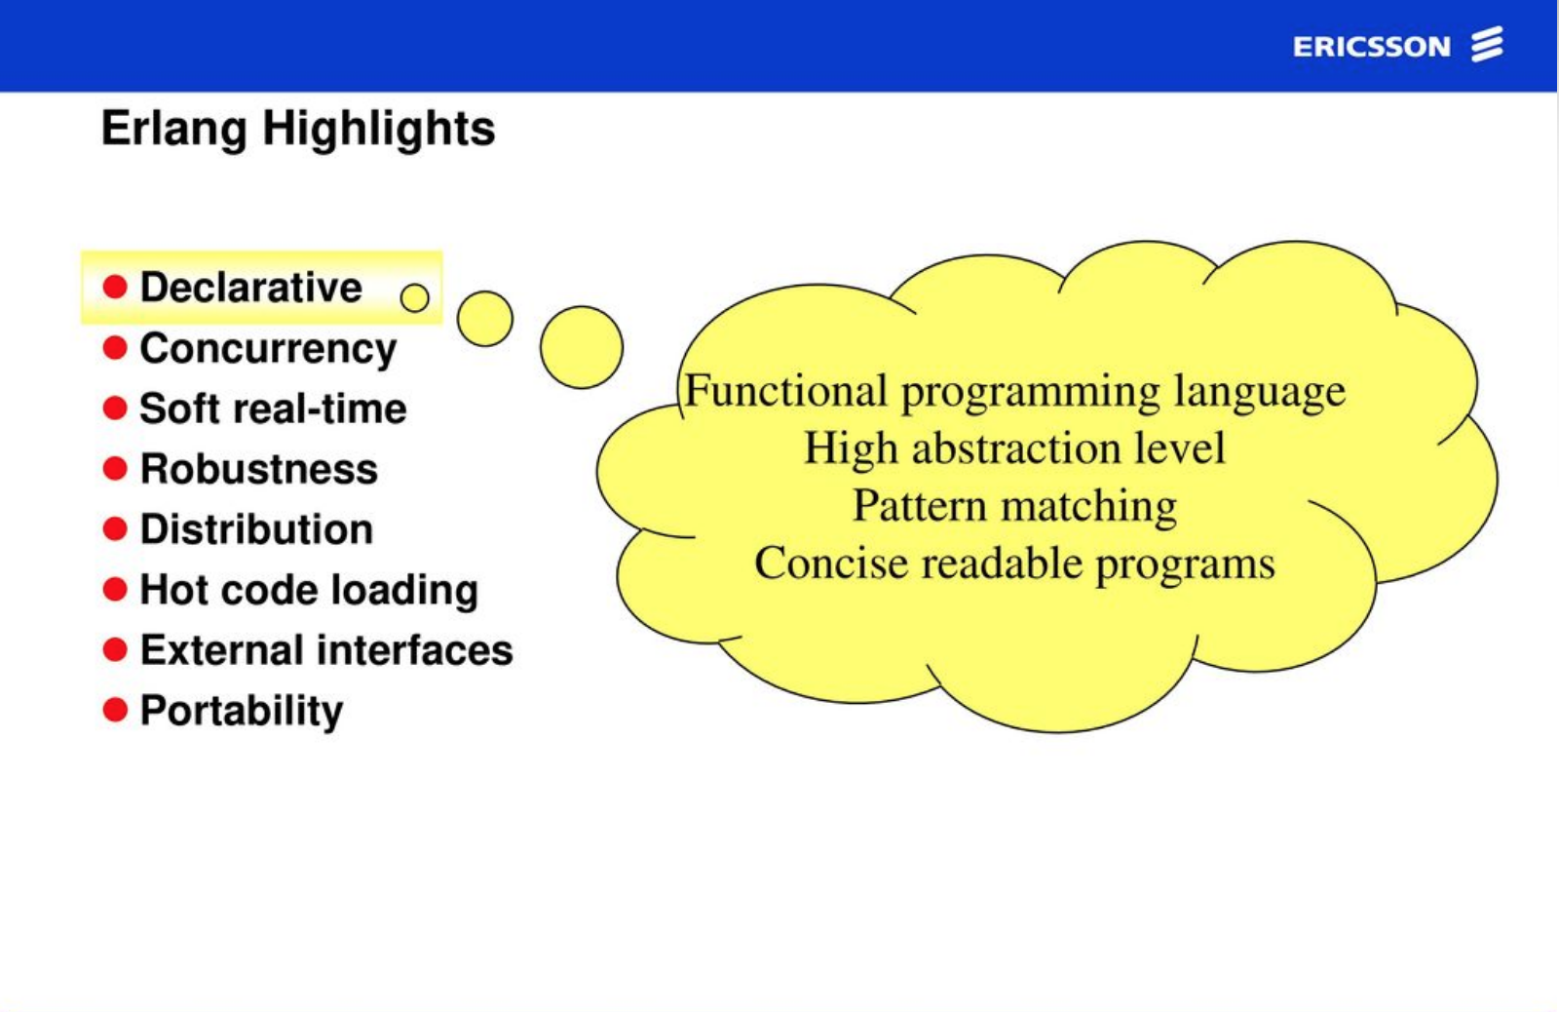
> philosophy

Slide 39
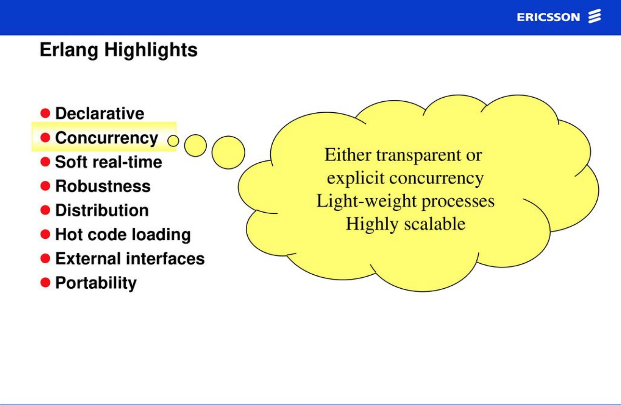
> philosophy
https://labs.zingat.com/parallelism-concurrency-paralellik-ve-e%C5%9Fzamanl%C4%B1l%C4%B1k-d530665f4223

Slide 40
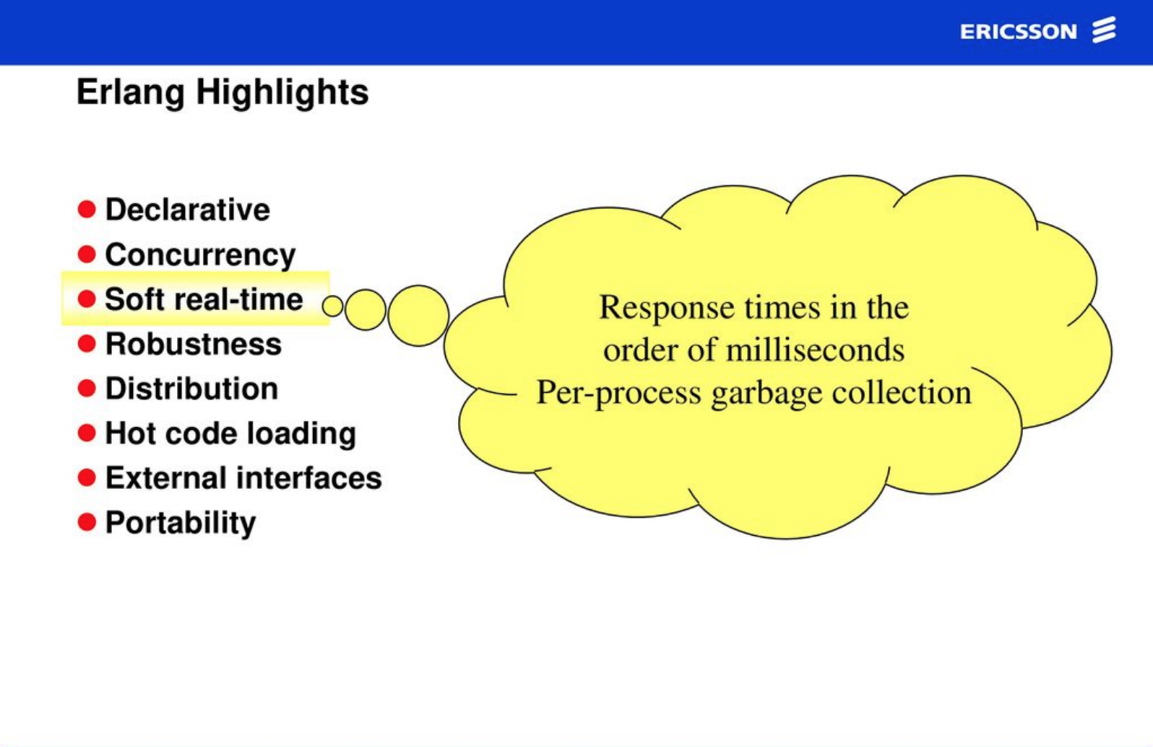
> philosophy

Slide 41
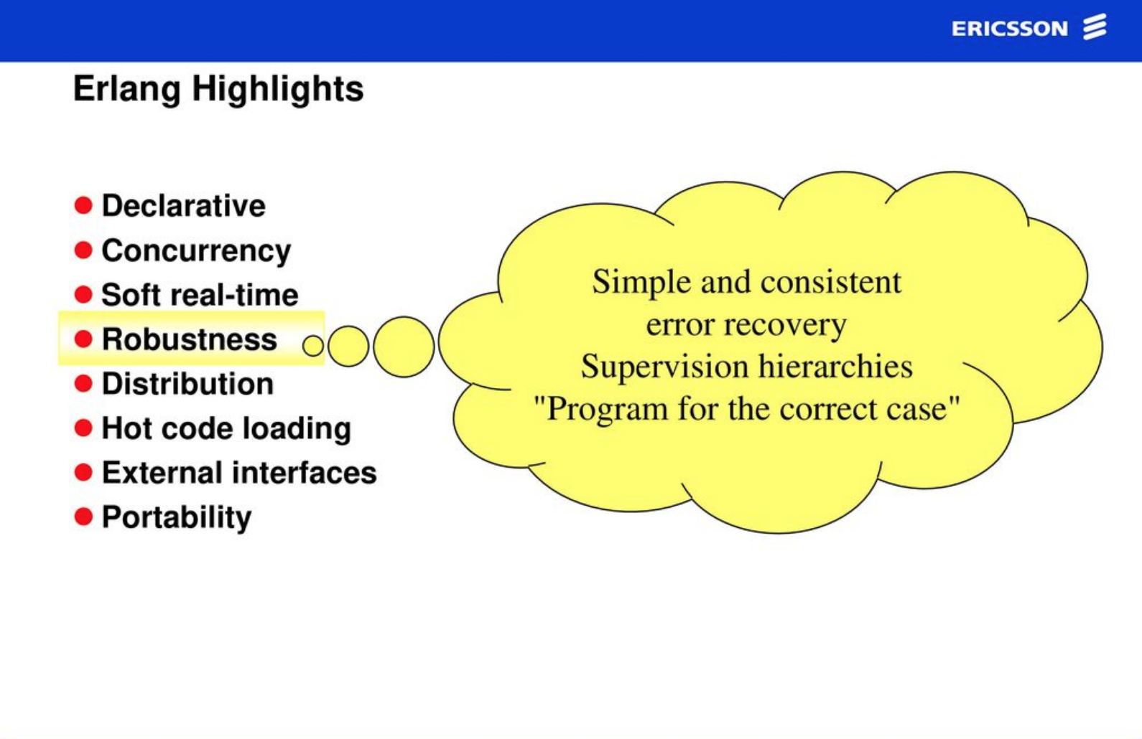
> philosophy

Slide 42
> fault tolerance
Fault tolerance means that the system can work even when components (software or hardware) fail.
To guard against the failure of an entire computer, we need two computers. | Joe Armstrong
Concurrent and distributed processes that can monitor each other from different computers.

Slide 43
> fault tolerance
If the first computer crashes, the failure is noticed by the second computer, which will try to correct the error.
The failure of one process must be corrected by another process when they’re on separate machines, Erlang uses that mechanism for all failures.
If Process A is monitoring Process B and Process B dies, Process A is notified.
When healthy processor notified, it could handle the crash report and it could starts the restart strategy or something else.

Slide 44
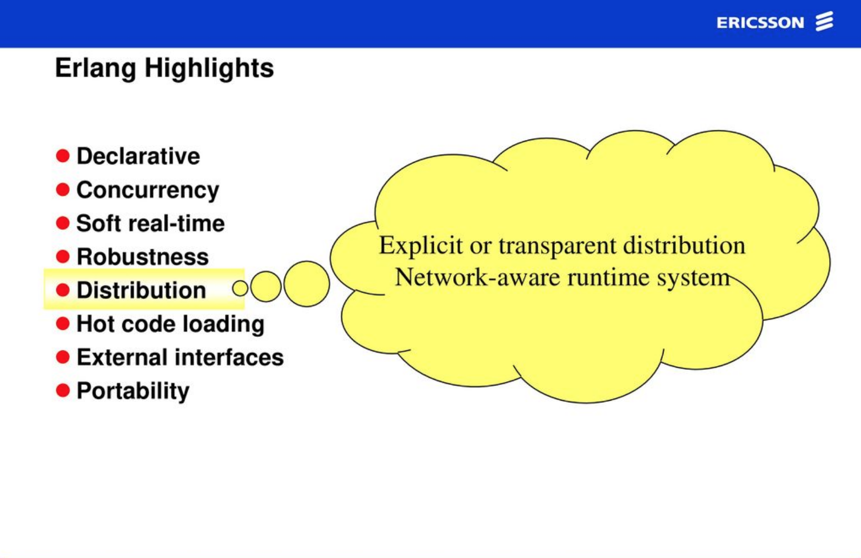
> philosophy

Slide 45
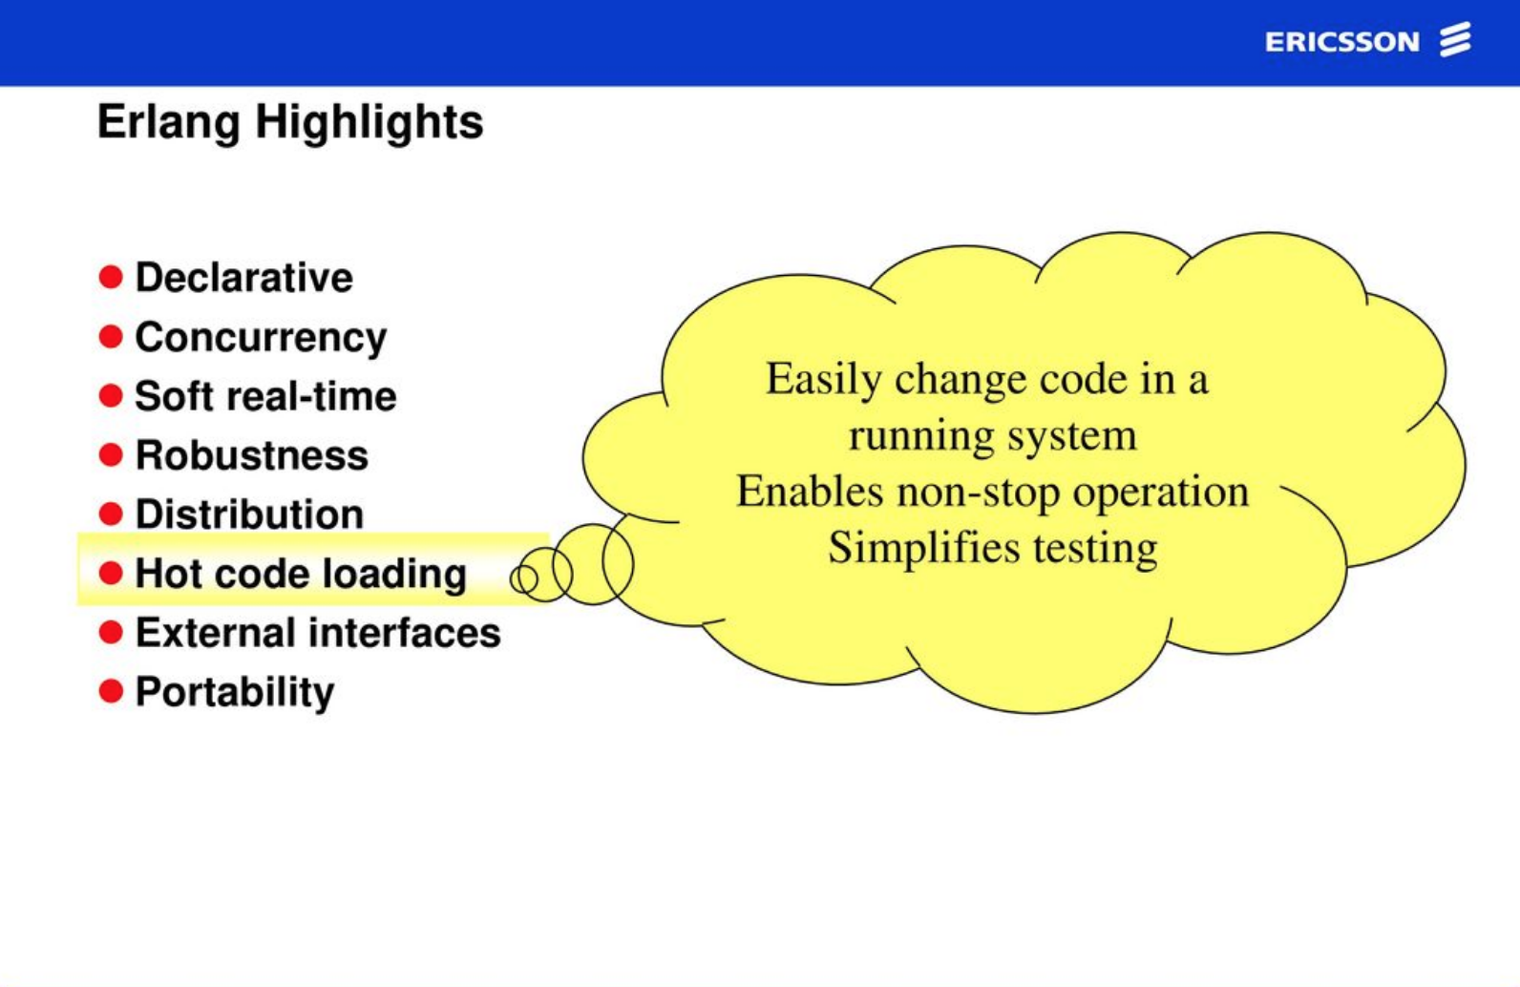
> philosophy

Slide 46
> code reload
In an Erlang system, it is easy to compile and load a replacement module for an existing one.
The BEAM emulator does the swap automatically without apparently stopping anything.
This makes it possible to do upgrades with essentially zero downtime.

Slide 47
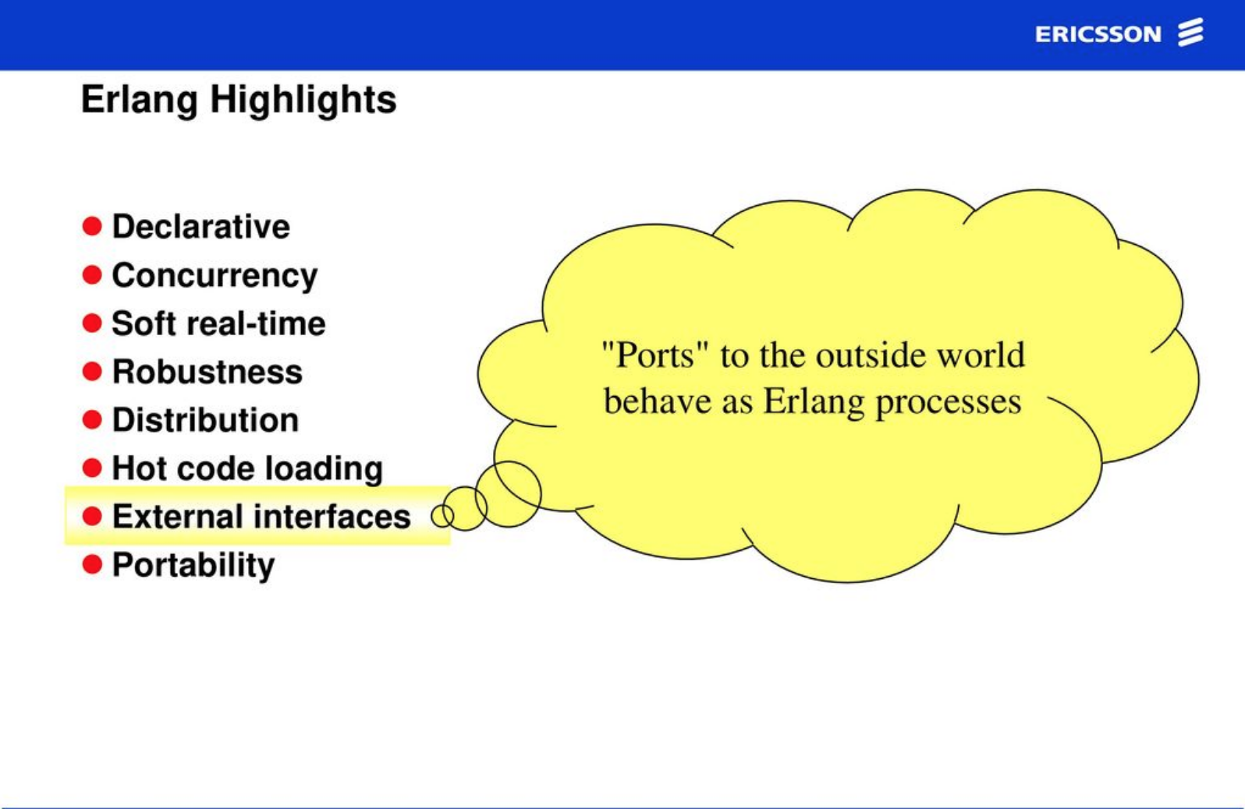
> philosophy

Slide 48
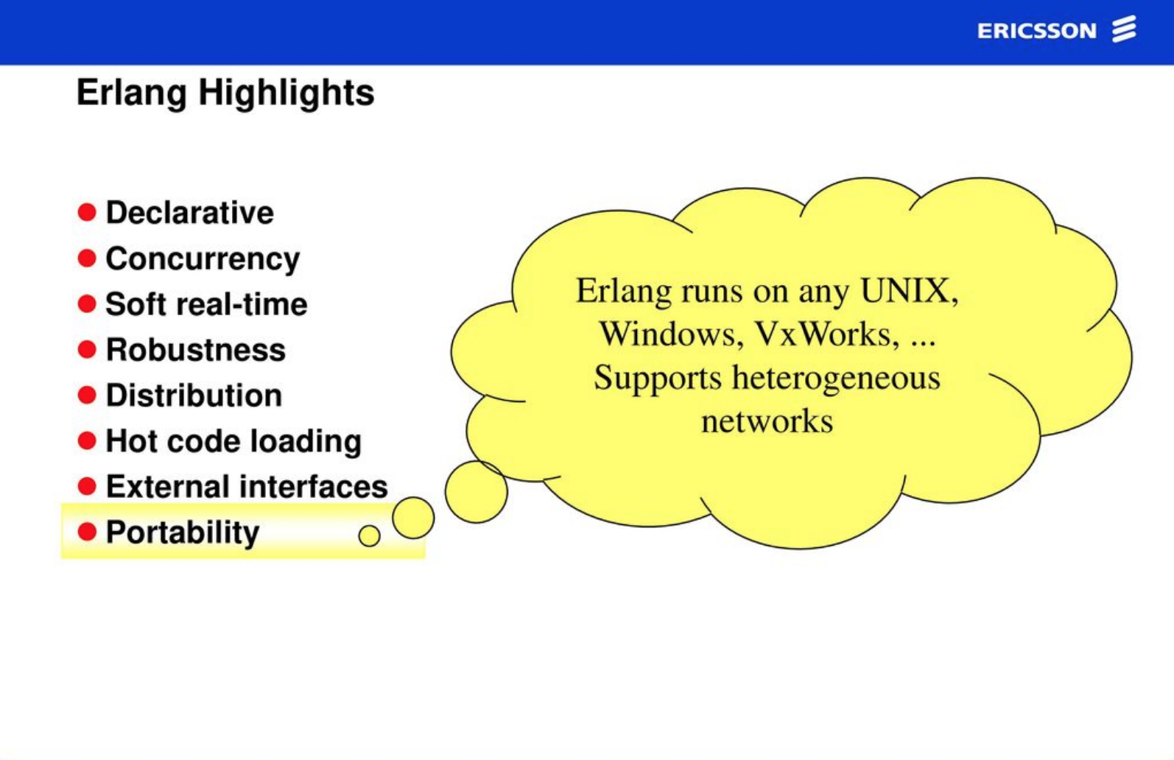
> philosophy

Slide 49
Who is using Erlang in productions?

Slide 50
> who is using?
Some of its uses are in telecoms, banking, e-commerce, computer telephony and instant messaging.

Slide 51


> who is using?
Original Facebook Messengers Channel Servers was implemented in Erlang.
WhatsApp server is almost completely implemented in Erlang.
FB Messenger

Slide 52
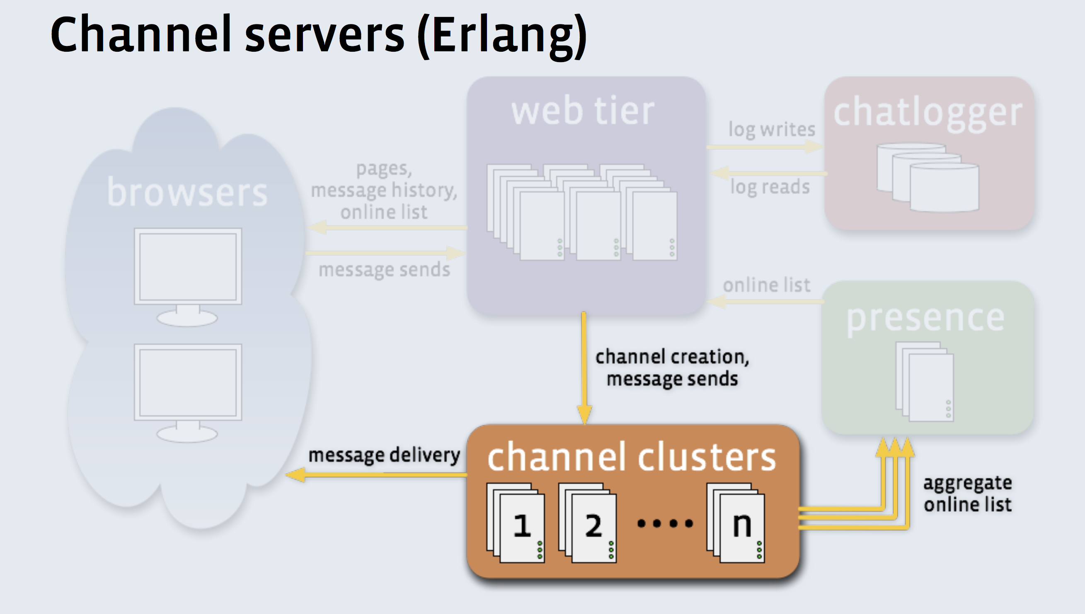
> who is using?
Original Facebook Messengers Channel Servers was implemented in Erlang.

Slide 53

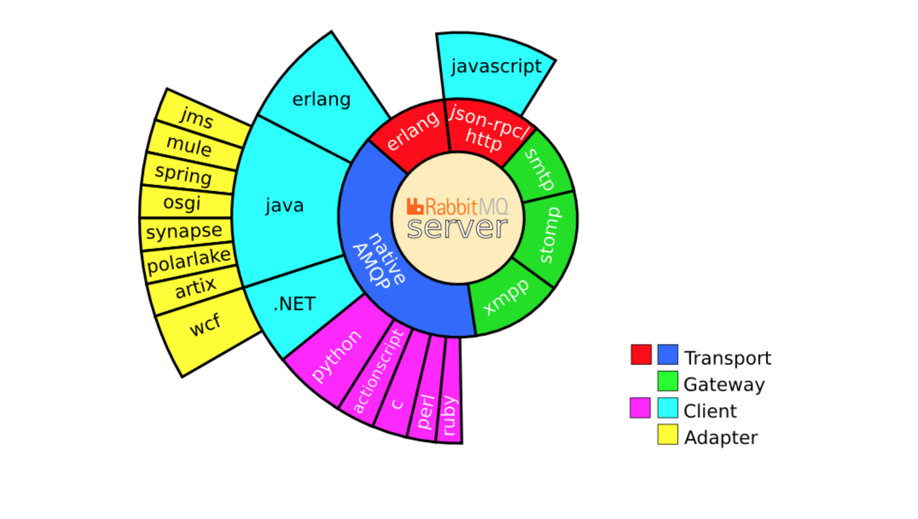
> who is using?

Slide 54
> who is using?
good architectural fit for AMQP
concise
concurrency
reliable
good performance, and it scales
excellent management and troubleshooting support
https://www.rabbitmq.com/resources/erlang-exchange-talk-final/ex.html

Slide 55
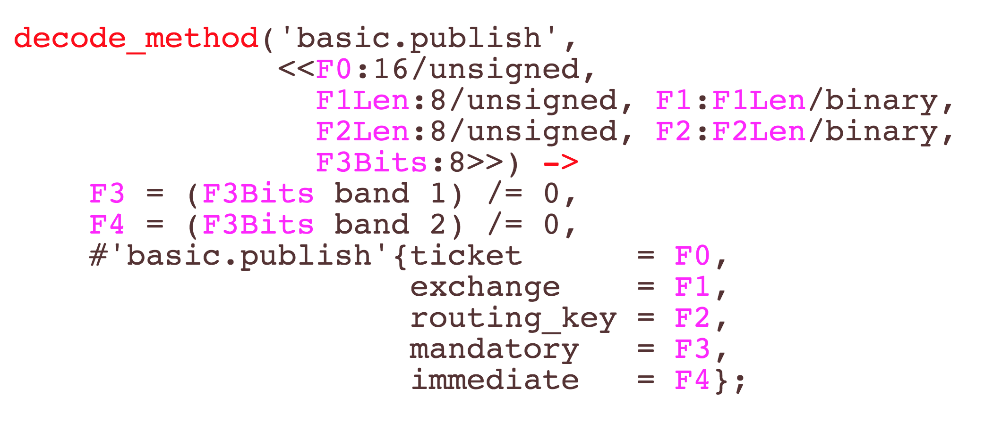
> who is using?

Slide 56

> who is using?
Cisco ships 2 million devices per year with Erlang on them.
90% of all internet traffic goes through Erlang controlled nodes.
Top 8 Service Providers & Network Equipment Providers use Erlang to control their systems.
Johan Bevemyr – CodeBEAMSTO | 2018

Slide 57
Next Episode : Development with Erlang

Slide 58


> whoami
Rıdvan Nuri Göçmen | Software Engineer
I turn ideas to working software products
+zingat.com
+mynet.com +gimora.com
and++
ridvannuri
rnglab
13 years+ hands on development

